Slide 1
Research Computing
Faculty of science and engineering

Slide 2
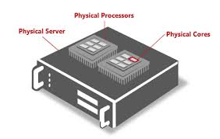
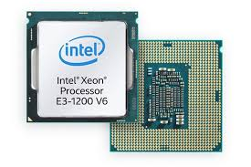
Research Compute
SocketS, Processors,Cores andThREADS

Slide 3
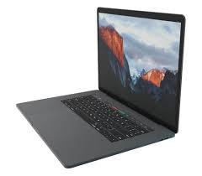
Research Compute
ON your DESK (or LAP)
A handful of Compute Cores
You have it already

Slide 4
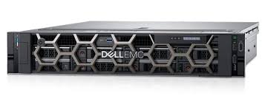
Research Compute
On Campus Compute
Multiple CPUs
10’s of Cores
$10,000’s

Slide 5
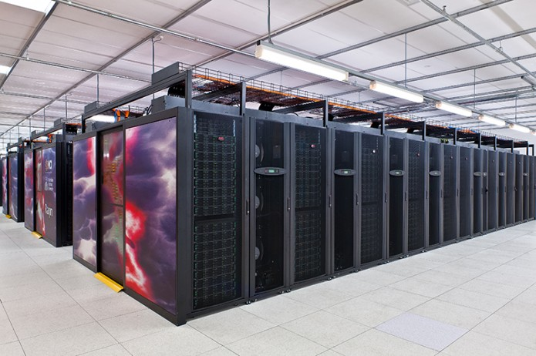
Research Compute
National COMPUTE INFRASTRUCTURE (NcI)
National Facility in Canberra
RAIJIN
4415 Compute Nodes
16 Cores each
3 TB of main memory
8 PB of storage
Sign up
Macquarie Subscription
my.nci.org.au

Slide 6
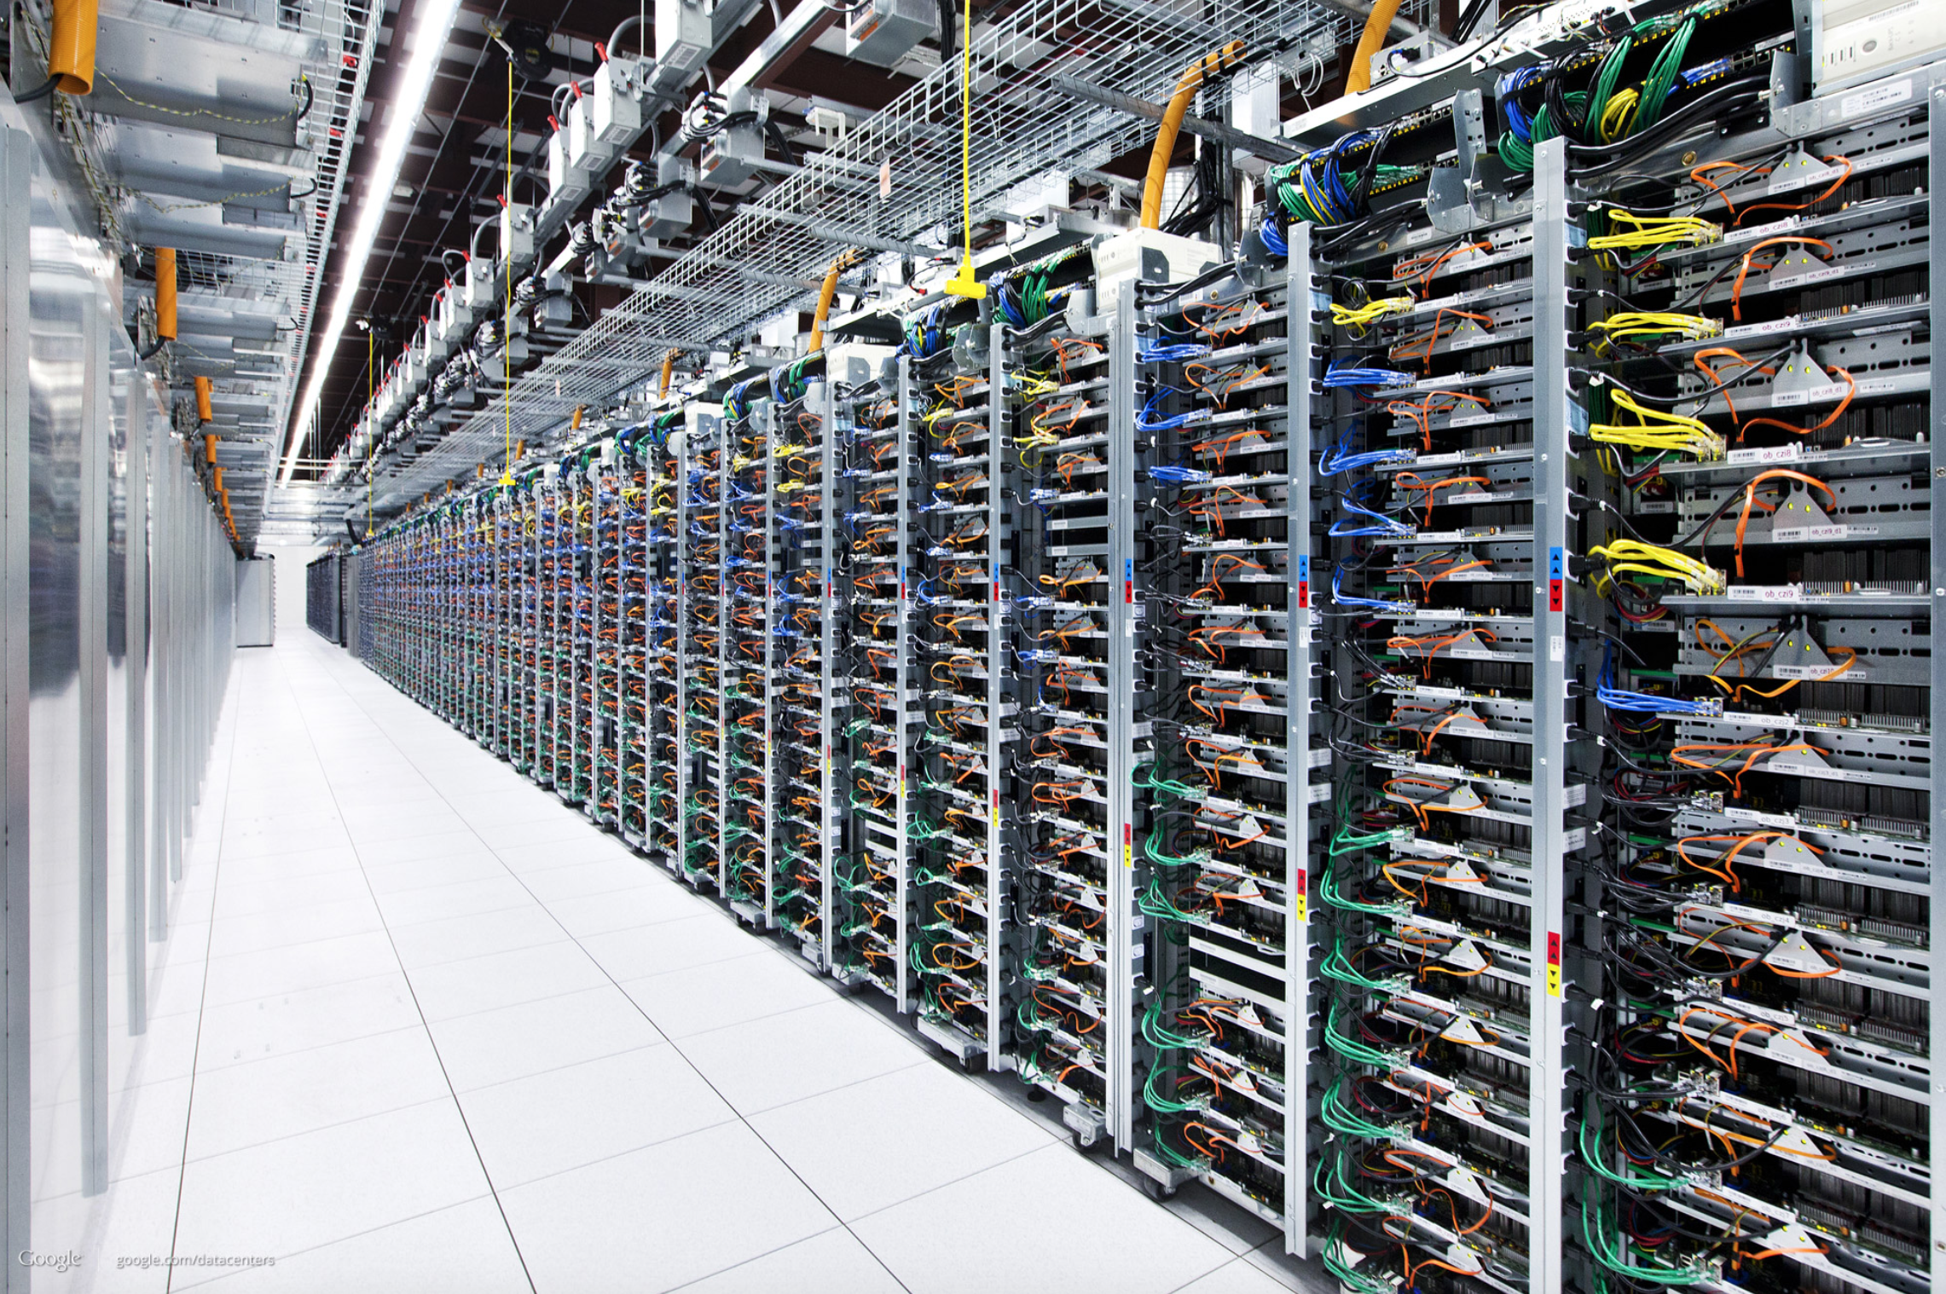
Research Compute
CLOUD Compute
Millions Servers
Billions of Cores
69 Availability Zones
https://www.infrastructure.aws

Slide 7
Research Compute
How Much is enough
Strategic Am I in the business compute based research ?
Academic How much computation is required to make my academic contribution ?
Scientific Should I find out more about computational methods ?
Engineering How can I optimise my code ?
Technology Facilities, resources, costings, technology etc ?

Slide 8
Questions ?

